Slide 1
Finite Automata
Nasreen Akhtar

Slide 2
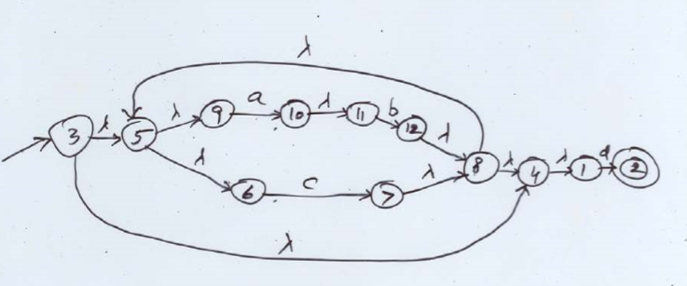
2nd method to convert NFA to DFA

Slide 3
2nd method to convert NFA to DFA
Design A TABLE HAVING 12 ROWS.
Each row for a single state
Label column with name of input and empty transition
Check transition of all input and enter it in table

Slide 4
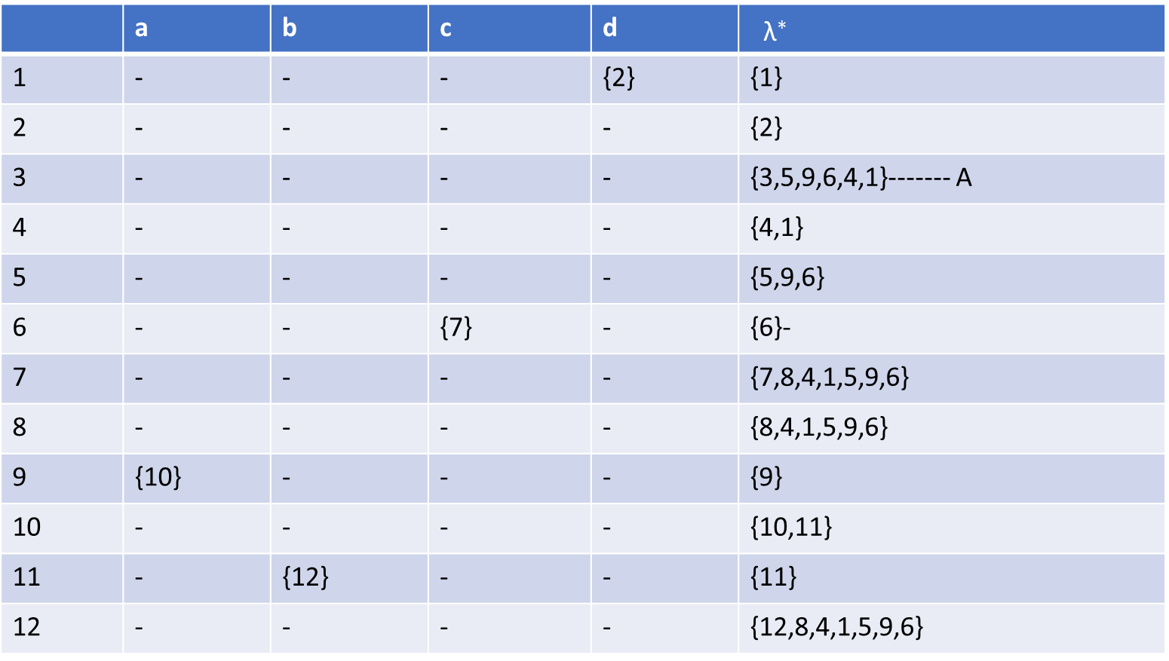
2nd method to convert NFA to DFA
 | a | b | c | d | ${ \text{λ}}^{∗}$
1 | - | - | - | {2} | {1}
2 | - | - | - | - | {2}
3 | - | - | - | - | {3,5,9,6,4,1}------- A
4 | - | - | - | - | {4,1}
5 | - | - | - | - | {5,9,6}
6 | - | - | {7} | - | {6}-
7 | - | - | - | - | {7,8,4,1,5,9,6}
8 | - | - | - | - | {8,4,1,5,9,6}
9 | {10} | - | - | - | {9}
10 | - | - | - | - | {10,11}
11 | - | {12} | - | - | {11}
12 | - | - | - | - | {12,8,4,1,5,9,6}

Slide 5
2nd method to convert NFA to DFA
Start from the start state
Check empty transition of each input alphbet

Slide 6
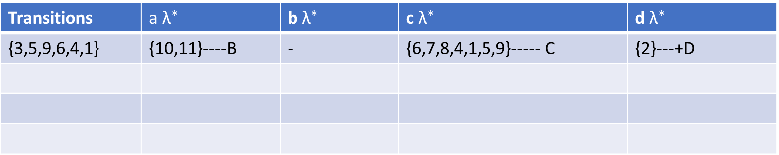
2nd method to convert NFA to DFA
Transitions | a${ \text{λ}}^{∗}$ | b${ \text{λ}}^{∗}$ | c${ \text{λ}}^{∗}$ | d${ \text{λ}}^{∗}$
{3,5,9,6,4,1} | {10,11}----B | - | {6,7,8,4,1,5,9}----- C | {2}---+D

Slide 7
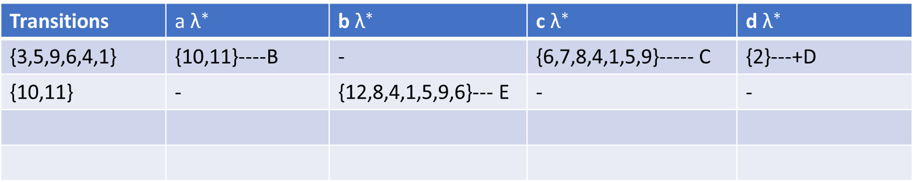
2nd method to convert NFA to DFA
Transitions | a${ \text{λ}}^{∗}$ | b${ \text{λ}}^{∗}$ | c${ \text{λ}}^{∗}$ | d${ \text{λ}}^{∗}$
{3,5,9,6,4,1} | {10,11}----B | - | {6,7,8,4,1,5,9}----- C | {2}---+D
{10,11} | - | {12,8,4,1,5,9,6}--- E | - | -

Slide 8
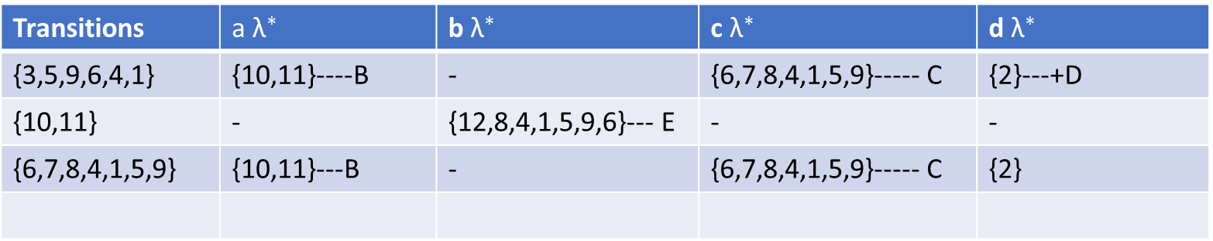
2nd method to convert NFA to DFA
Transitions | a${ \text{λ}}^{∗}$ | b${ \text{λ}}^{∗}$ | c${ \text{λ}}^{∗}$ | d${ \text{λ}}^{∗}$
{3,5,9,6,4,1} | {10,11}----B | - | {6,7,8,4,1,5,9}----- C | {2}---+D
{10,11} | - | {12,8,4,1,5,9,6}--- E | - | -
{6,7,8,4,1,5,9} | {10,11}---B | - | {6,7,8,4,1,5,9}----- C | {2}

Slide 9
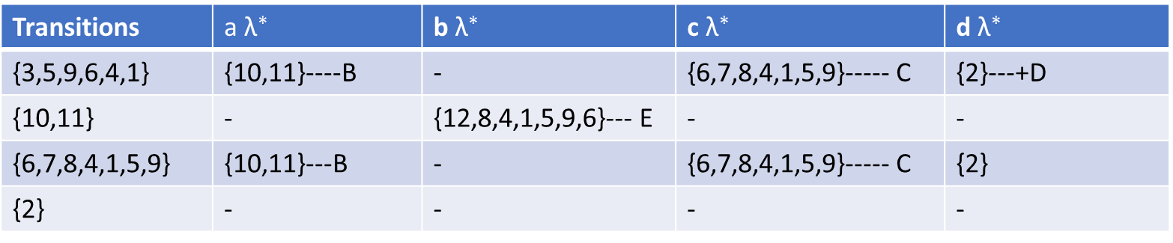
2nd method to convert NFA to DFA
Transitions | a${ \text{λ}}^{∗}$ | b${ \text{λ}}^{∗}$ | c${ \text{λ}}^{∗}$ | d${ \text{λ}}^{∗}$
{3,5,9,6,4,1} | {10,11}----B | - | {6,7,8,4,1,5,9}----- C | {2}---+D
{10,11} | - | {12,8,4,1,5,9,6}--- E | - | -
{6,7,8,4,1,5,9} | {10,11}---B | - | {6,7,8,4,1,5,9}----- C | {2}
{2} | - | - | - | -

Slide 10
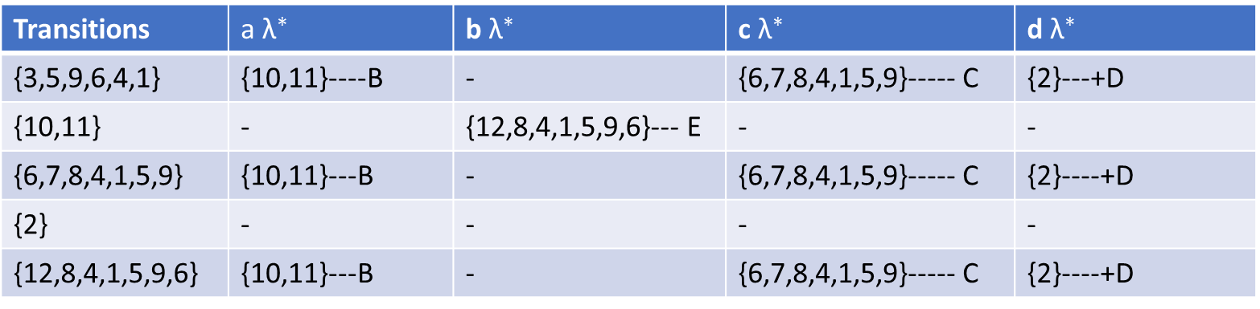
2nd method to convert NFA to DFA
Transitions | a${ \text{λ}}^{∗}$ | b${ \text{λ}}^{∗}$ | c${ \text{λ}}^{∗}$ | d${ \text{λ}}^{∗}$
{3,5,9,6,4,1} | {10,11}----B | - | {6,7,8,4,1,5,9}----- C | {2}---+D
{10,11} | - | {12,8,4,1,5,9,6}--- E | - | -
{6,7,8,4,1,5,9} | {10,11}---B | - | {6,7,8,4,1,5,9}----- C | {2}----+D
{2} | - | - | - | -
{12,8,4,1,5,9,6} | {10,11}---B | - | {6,7,8,4,1,5,9}----- C | {2}----+D

Slide 11
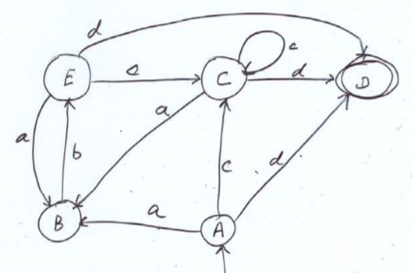
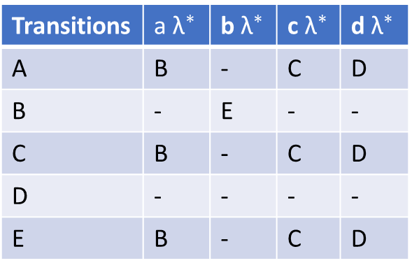
2nd method to convert NFA to DFA
Simplify that table
Transitions | a${ \text{λ}}^{∗}$ | b${ \text{λ}}^{∗}$ | c${ \text{λ}}^{∗}$ | d${ \text{λ}}^{∗}$
A | B | - | C | D
B | - | E | - | -
C | B | - | C | D
D | - | - | - | -
E | B | - | C | D

